Slide 1


Slide 2

It is disturbing to note that even today, there are places like
Kalahandi and Kashipur in Orissa where famine- like conditions have been existing for many years and where some starvation deaths have also been reported.
Starvation deaths are also reported in Baran district of Rajasthan, Palamau district of Jharkhand and many other remote areas during the recent years.
Therefore, food security is needed in a country to ensure food at all times.

Slide 3

Worst affection groups in rural areas are:
Landless people
Traditional artisans
Traditional services providers
Petty self-employed workers
Homeless, beggars etc.

Slide 4
Worst affection groups in urban areas are:
People employed in ill-paid occupations and casual labour market.
social composition also plays very important role in food insecurity:
The SCs, STs
some sections of the OBCs (lower castes among them)

Slide 5
Migrants (due to natural disaster)
Women and children under the age of 5 years All these constitutes an important segment of the food insecure population.
According to the National Health and Family Survey (NHFS) 1998–99, the number of such women and children is approximately 11 crore.

Slide 6
Uttar Pradesh (eastern and south-eastern parts)
Bihar
Jharkhand
Orissa
West Bengal
Chhattisgarh
parts of Madhya Pradesh and Maharashtra

Slide 7

Another aspect of food insecurity.
The attainment of food security therefore involves eliminating current hunger and reducing the risks of future hunger.

Slide 8

CHRONIC
is a consequence of diets persistently inadequate in terms of quantity and/or quality.
Poor people suffer from chronic hunger because of their very low income and in turn inability to buy food even for survival.
is related to cycles of food growing and
harvesting
This is prevalent in rural areas because of the seasonal nature of agricultural activities and in urban areas because of casual labourers
SEASONAL

Slide 9

India adopted a new strategy in agriculture, which resulted in ‘Green Revolution’.
Food grain production especially: Wheat and Rice
The Green Revolution in India refers to a period of time when agriculture in India changed to an industrial system due to the adoption of modern methods and technology such as high yielding variety (HYV) seeds, tractors, irrigation facilities, pesticides, fertilizers etc.

Slide 10
Indira Gandhi, the then Prime Minister of India, officially recorded the impressive strides of Green Revolution in agriculture by releasing a special
stamp entitled ‘Wheat Revolution’ in July 1968
Uttar Pradesh and Madhya Pradesh recorded a significant production in field of wheat.
West Bengal and UP, on the other hand, recorded significant production of rice.

Slide 11
 Government of India designed food security system. This system has two components:
buffer stock and
public distribution system.

Slide 12

Buffer Stock is the stock of foodgrains, namely wheat and rice, procured by the government through the Food Corporation of India (FCI).
The FCI purchases wheat and rice at MSP(Minimum Support Price) from the farmers in states where there is surplus production.

Slide 13

The MSP is declared by the government every year before the sowing season to provide incentives to farmers for raising the production of these crops.
MSP is pre-fixed price by the government to protect the producer-farmers- against excessive fall in price during bumper production years.

Slide 14

 This is done to distribute food grains in the deficit areas and among the poorer strata of the society at a price lower than the market price also known as Issue Price.

Slide 15

The food procured by the FCI is distributed through government regulated ration shops among the poorer section of the society. This is called the Public Distribution System (PDS)
There are about 5.5 lakh ration shops all over the country. Ration shops also, known as Fair Price Shops, keep stock of foodgrains, sugar, and kerosene for cooking.

Slide 16
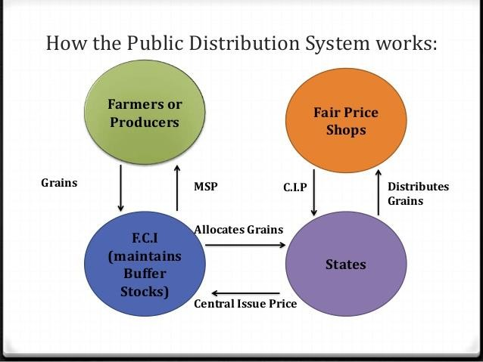

Slide 17

 There are three kinds of ration cards:
AAY cards
BPL cards
APL cards

Slide 18
S . No | Ration Card Type | Eligible families
1. | BPL (Below Poverty Line) cards. | The BPL cards are provided to the citizens who live below the poverty line and their annual income is less than Rs . 10,000/-
2. | APL (Above Poverty Line) cards. | The APL cards are provided to the citizens of Uttar Pradesh who are above the poverty line and have their annual income above Rs . 10,000/-
3. | AAY cards. | The AAY cards are issued to the citizens of Uttar Pradesh who are very poor and do not have any stable income source.

Slide 19
 In the wake of the high incidence of poverty levels, as reported by the NSSO in the mid- 1970s, three important food intervention programmes were introduced:
Public Distribution System(PDS)
Integrated Child Development Services (ICDS)
Food-for-Work (FFW)

Slide 20

Integrated Child Development Services (ICDS) is a government programme in India which provides food, preschool education, and primary healthcare to children under 6 years of age and their mothers.
The scheme was launched in 1975, discontinued in 1978 by the government of Morarji Desai, and then relaunched by the Tenth Five Year Plan.

Slide 21
Tenth five year plan also linked ICDS to Anganwadi centres established mainly in rural areas and staffed with frontline workers.
In addition to fighting malnutrition and ill health, the programme is also intended to combat gender inequality by providing girls the same resources as boys.

Slide 22
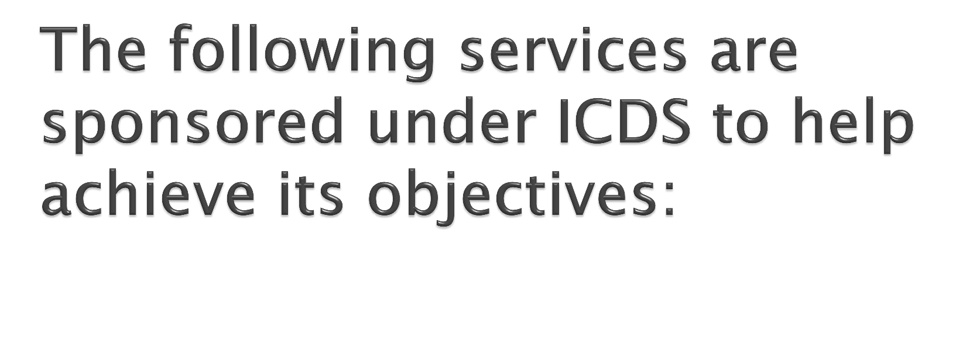
Immunization
Supplementary nutrition
Health checkup
Referral services
Pre-school education(Non-Formal)
Nutrition and Health information

Slide 23

 Food For Work Programme. The Introduction of Food for Work and Amendments. The Program was introduced in 1977-78 by giving food grains instead of wages.

Slide 24

diverting the grains to open market to get better margin.
selling poor quality grains at ration shops.
irregular opening of the shops.

Slide 25

The cooperative societies set up shops to sell low priced goods to poor people. For example, out of all fair price shops running in Tamil Nadu, around 94 per cent are being run by the cooperatives.
Similarly In Delhi, Mother Dairy, Amul is another success story of cooperatives in milk and milk products from Gujarat

Slide 26
Similarly, in Maharashtra, Academy of Development Science (ADS) has facilitated a network of NGOs for setting up grain banks in different regions.
ADS organises training and capacity building programmes on food security for NGOs.

Slide 27


